Slide 1
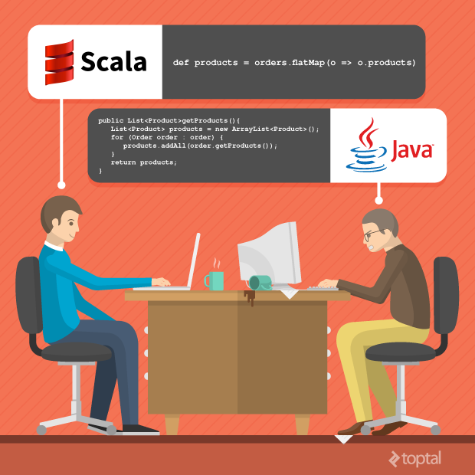
Scala for java dev

Slide 2
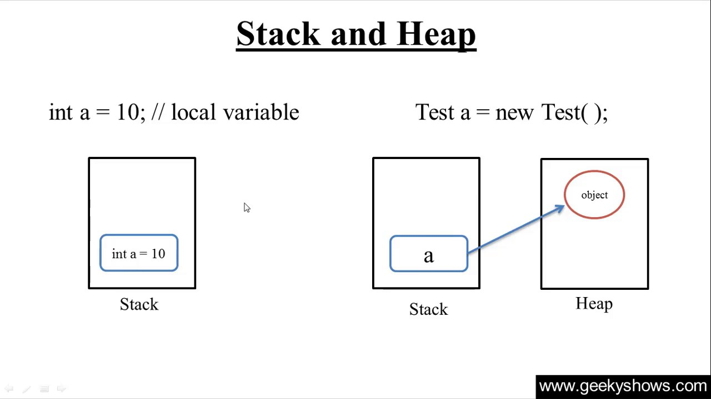
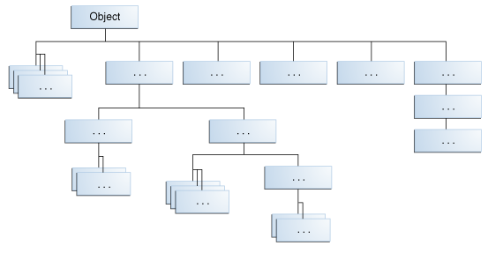
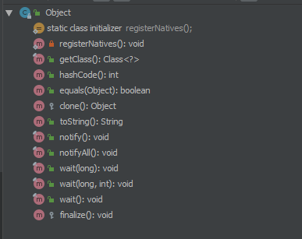
Java Class Hierarchy and Data Types
Primitive data types(bytes, long, int, char...)
Object data types(String, File, Exceptions...MyClass...)

Slide 3
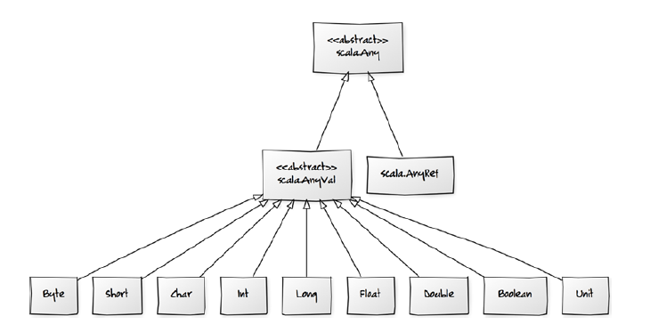
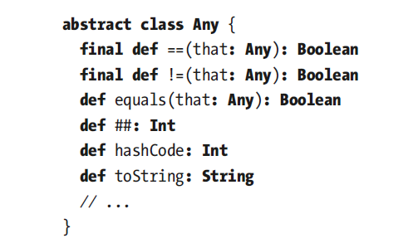
Scala Class Hierarchy and Data Types
Primitive data types no exists
Primitive data types in scala is call “value types”
The “value types” extend the Any and AnyVal

Slide 4
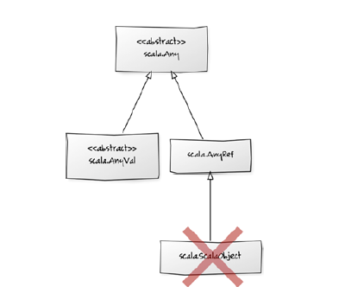
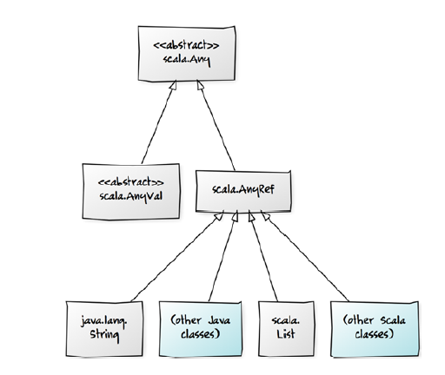
Scala Class Hierarchy and Data Types
Scala Parent Object not exists
Object data types in scala is call “reference types”
The “reference types” extend the Any and AnyRef

Slide 5
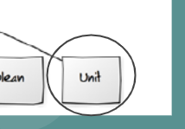

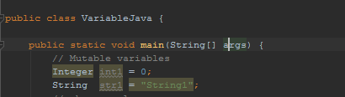
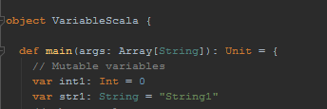
Scala Unit Value Type
Value Type Unit represent a void result

Slide 6
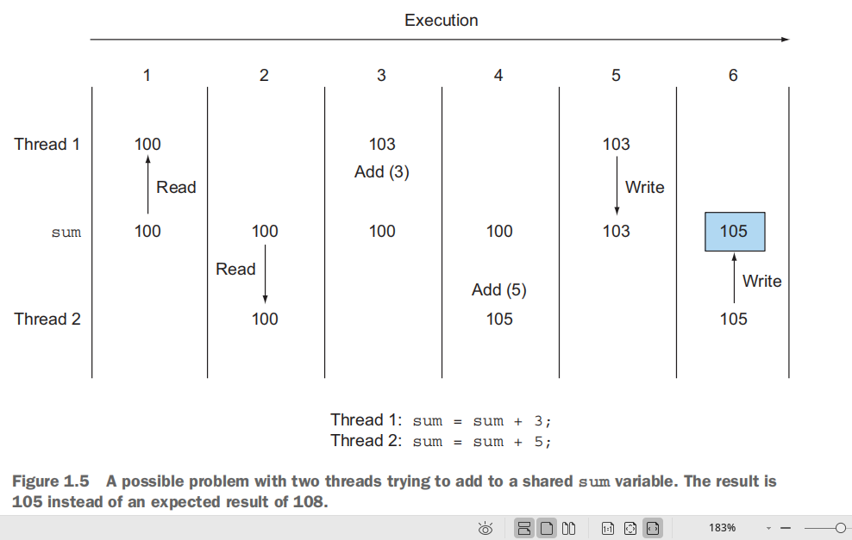
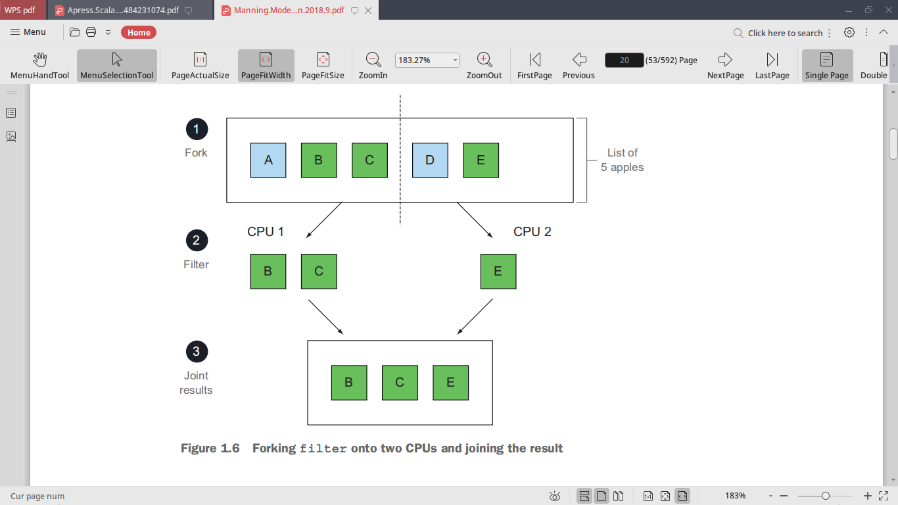
Variables mutable and immutable
Why is important considerer what of strategy variable we use?
Because in modern applications we must think about the concurrent and paralleling programs
inmutables variables can helps with us :-)

Slide 7
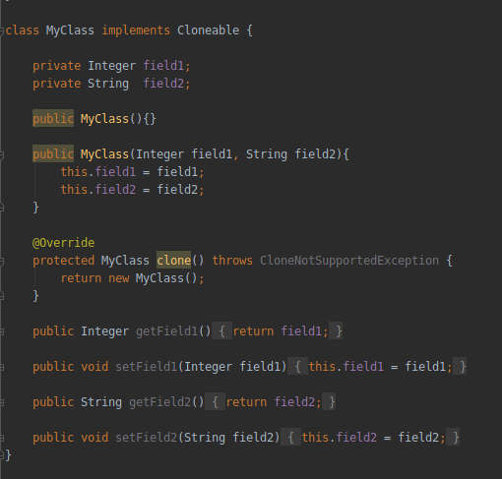
Java Variables mutable and immutable
Java provided the mutable variables for default
You must implement the Cloneable interface to do a copy of the object, but, It doesn't garatiens a “deep copy”
There are some alternatives for “deep copy” for example
“SerializationUtils.clone” apache commons lang library

Slide 8
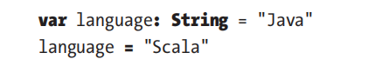
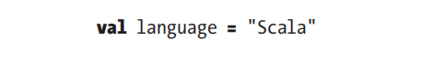
Scala Variables mutable and immutable
Scala provides variable and values concepts(var and val)
Variables can modify the value
Overwise, Values can’t modify ours values

Slide 9
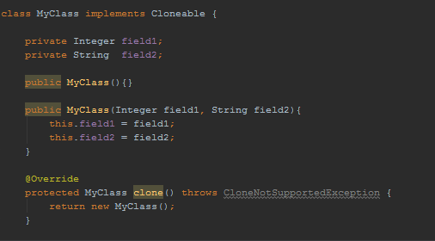
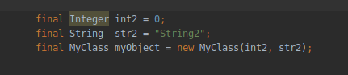
Java Create Classes and Objects
Java Classes
Java Objects

Slide 10


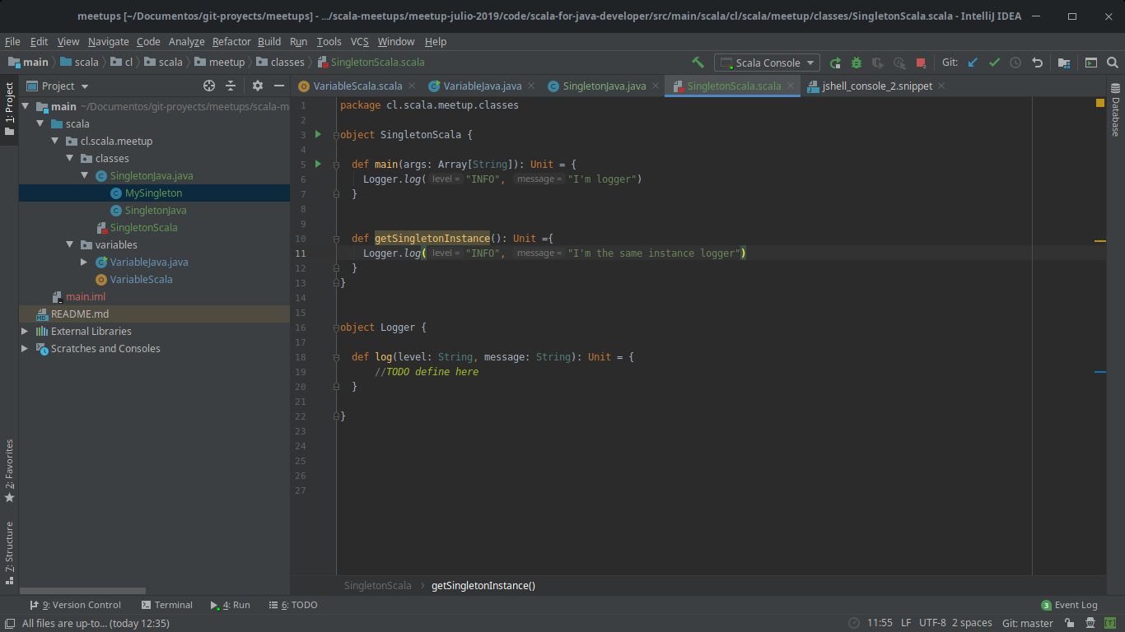

Scala Create Classes and Reference Types
Scala Classes
Scala Objects
Scala Singleton Classes
Scala Singleton Object

Slide 11
Scala Companion Objects
Scala Classes
Scala Objects
Scala Singleton Classes
Scala Singleton Object

Slide 12

Scala Class Hierarchy and Data Types
Example the a comparing

